Slide 1
Vocabulary 7

Slide 2
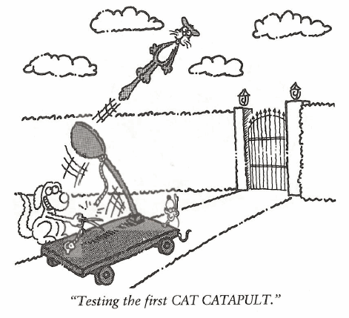
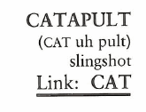
Catapult (N, V)
The Nascar entry won at Indianapolis by drafting behind the lead car and CATAPULTING forward to take the lead at the finish line.

Slide 3
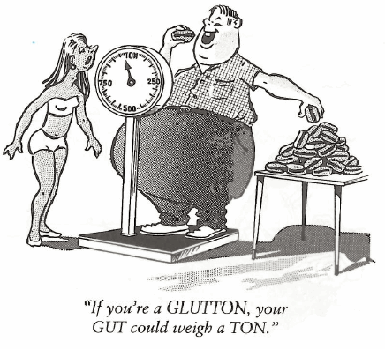
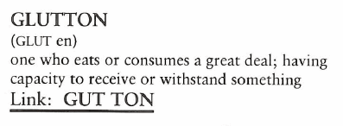
Glutton (N)
Every day during school lunch the Pitts children behave in a GLUTTONOUS manner, so much so, it made one wonder if they were ever fed at home.

Slide 4
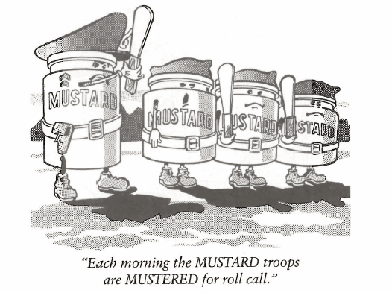
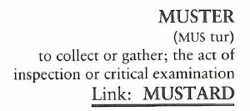
Muster (V, N)
The restaurant owner inspected the kitchen and said the eating utensils did not pass MUSTER, and told the dish washer to wash them all over again.

Slide 5
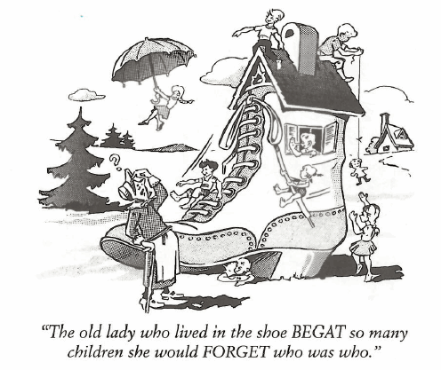
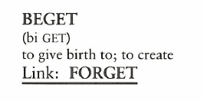
Beget (V)
Chronic lying becomes a habit which starts out with one small lie, which BEGETS a second lie, which BEGETS a third lie, and so on.

Slide 6
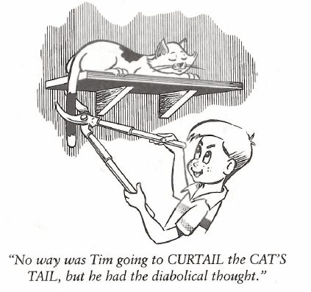
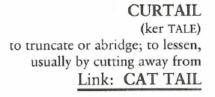
Curtail (V)
Sheriff McDougall CURTAILED all further night patrols east of the river until bullet-proof windows were installed in his patrol cars.

Slide 7
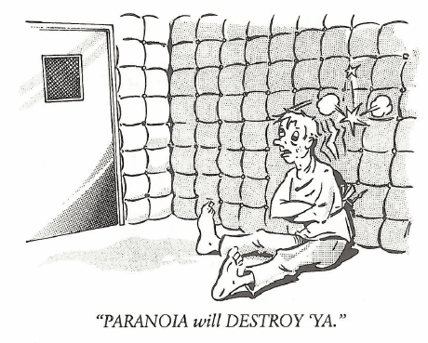
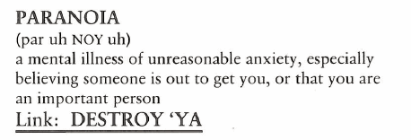
Paranoia (N)
(A person suffering from PARANOIA is said to be PARANOID). Joshua was absolutely PARANOID about walking under a ladder.

Slide 8
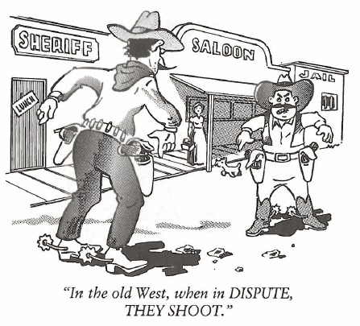
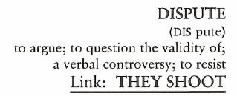
Dispute (N, V)
“I DISPUTE that argument, sir,” said the senator from Georgia.

Slide 9
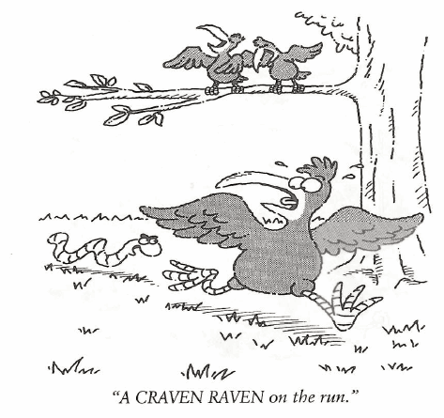
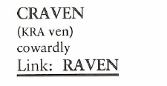
Craven (N, Adj)
The soldier was full of bluster about how bravely he would fight, but his comrades later found him to be CRAVEN once the battle started.

Slide 10
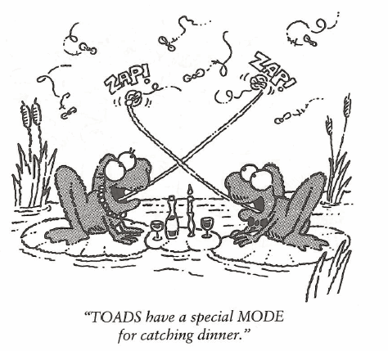
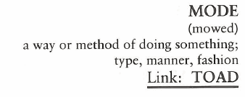
Mode (N)
Once he became a lawyer, Hal put aside his jeans and dressed in the MODE of his contemporaries—conservative dark suits, white shirts and ties.

Slide 11
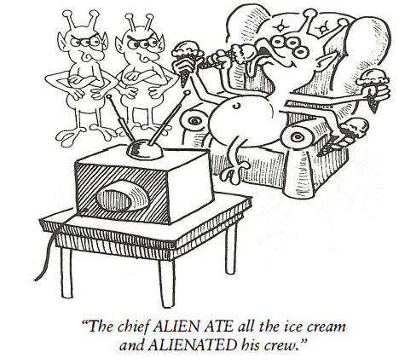
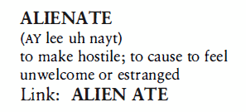
Alienate (V)
All during school, Bob Smith felt ALIENATED by the other students because he wore his hair down to his knees.

